Slide 1
MECHANICAL TEAM WEEK 10 PROGRESS REPORT
MEMBERS
Ian Mutisya
Isaac Ngugi
Peter Nzioki
Clinton Otieno
Catherine Kipkazi
Kennedy Ouma

Slide 2
Tasks done
Wheelbase modification
Steering fabrication
Taper turning

Slide 3
Taper turning
Taper was done to the flywheel-motor coupling. This was done so that it can fit into the flywheel bore.
It was done using a lathe machine in the machine shop
Key cutting is still in progress

Slide 4
Wheelbase modification
By assuming the whole tractor being a simply supported beam and the wheels to be the supports, calculations were done so as to determine the new front wheel position.
We were able to extend the wheelbase by 200mm after calculations.
ASSUMPTIONS
The tractor was assumed to be a simply supported beam with the wheels as the reaction points.
The modification balanced out the reactions at the wheels to Ra=Rb to be 4.8kN.
-

Slide 5
Before the modification,the reaction force at the front wheels was 5.2kN, & the rear 4.4kN. This added load to the front wheels increases tire load and steering load making turning difficult and unstable on banked road surfaces. The rear had reduced tire load increasing risk of slippage.since the tractor’s torque is transmitted to them. Reduced traction at the rear will impede operations on soft agricultural soils and in wet conditions.
Balancing of the tire load enables;
-less steering force
- pitching is minimized
-yawing chances are significantly reduced.

Slide 6
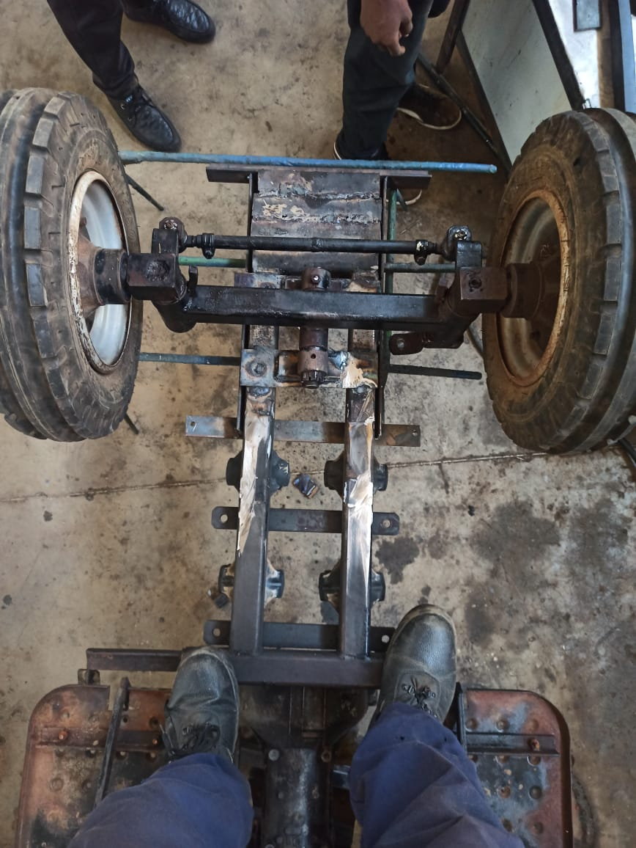
FLIP ORIENTATION

Slide 7
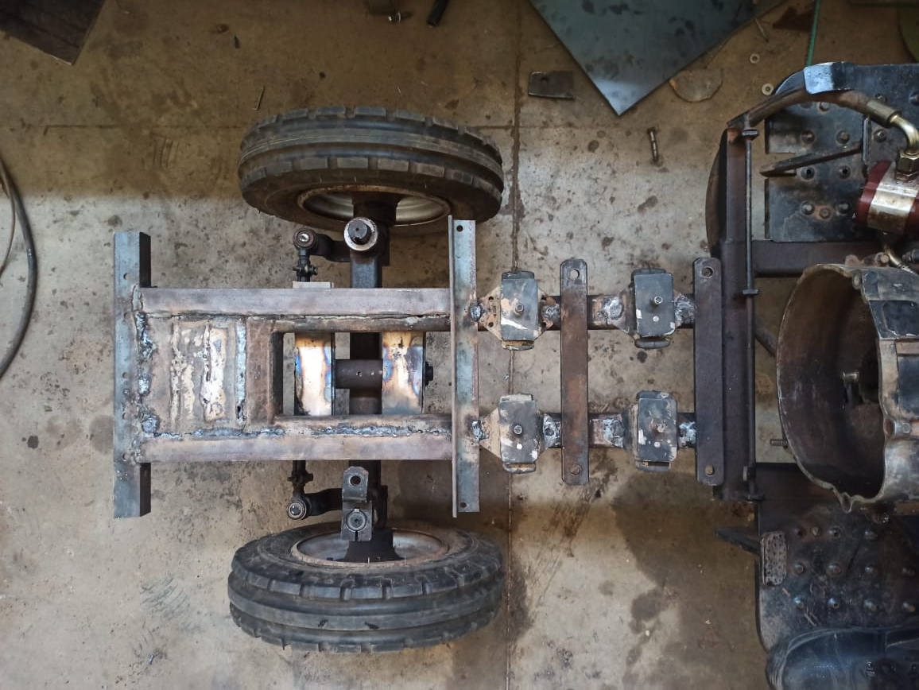
TOP VIEW ORIENTATION

Slide 8
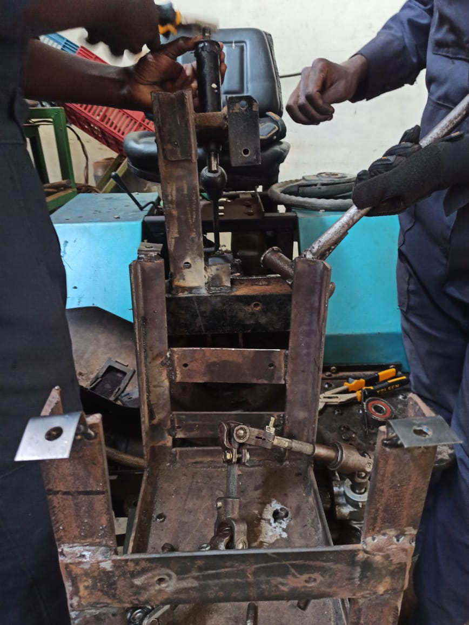
STEERING INSTALLATION PROCESS

Slide 9
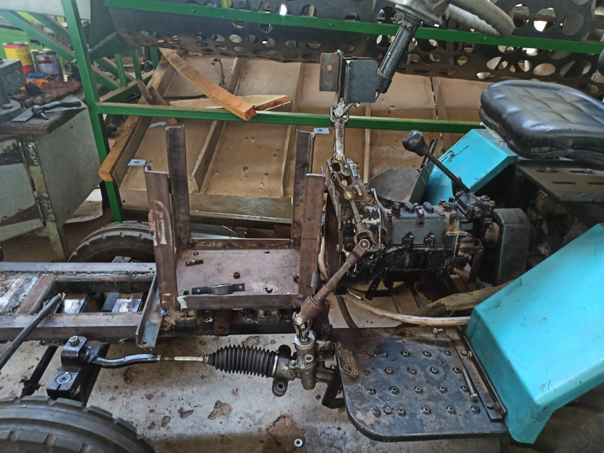
STEERING

Slide 10
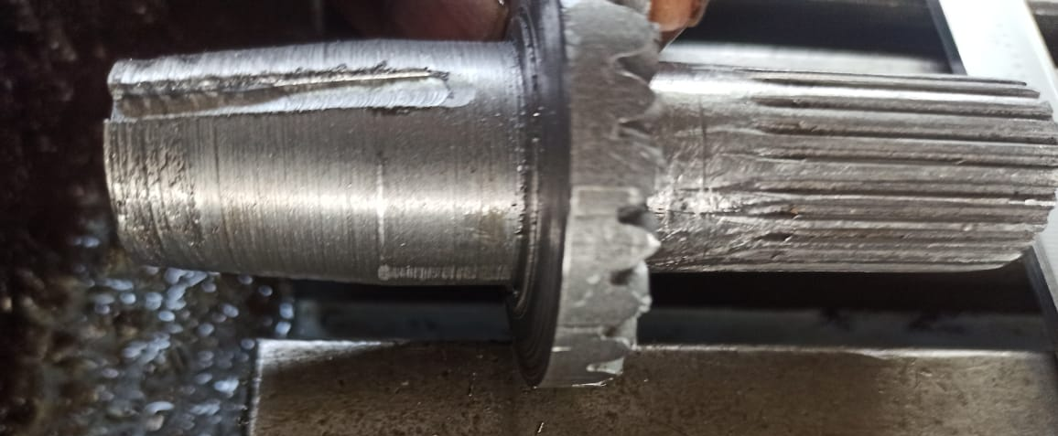
KEYED AND TAPERED

Slide 11
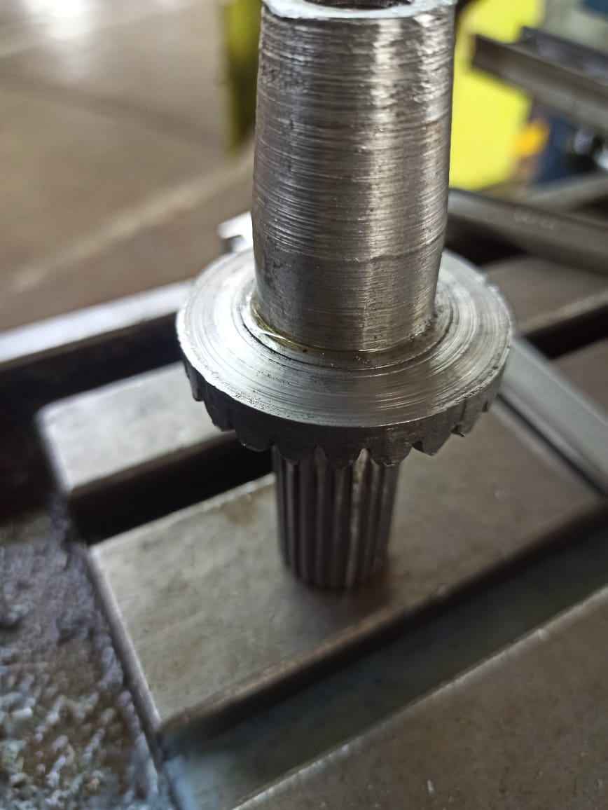

Slide 12
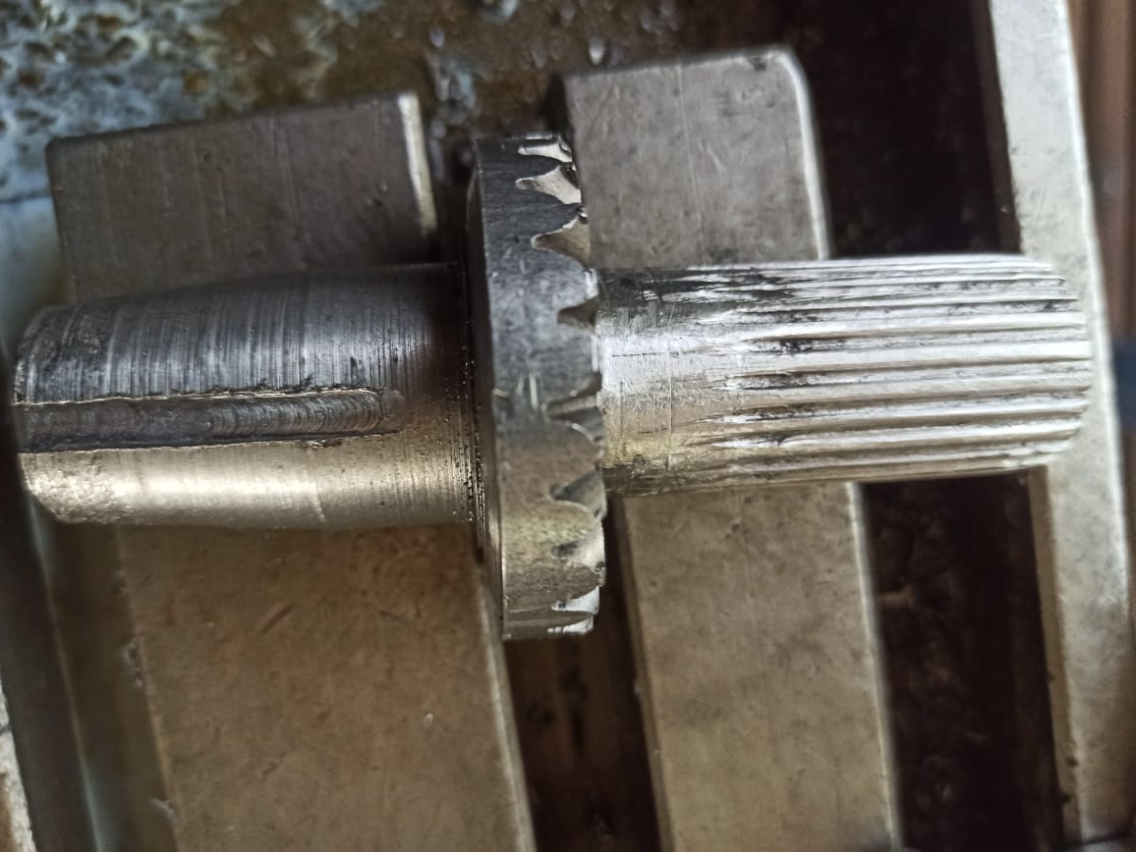

Slide 13
